Slide 1
imMens: Real-time Visual Querying of Big Data
Zhicheng Liu⋆, Biye Jiang‡ and Jeffrey Heer⋆
presenter
Tao mo

Slide 2
Content
1 Introduction
2 Related Work
3 Techniques Being Used
4 Demo
5 Future Work

Slide 3
Introduction
Data Visualization - Big Data
Traditional data visualization tools are often inadequate
Notes:
Traditional data visualization tools are often inadequate to handle big data.
More generally, many data sets are too large to fit in memory and may be distributed across a cluster;

Slide 4
Introduction
Data Visualization - Big Data
Two challenges:
Solution?
perceptual
Data reduction methods
resolution of conventional displays (~1-3 million pixels)
interactive scalability
Querying large data stores can incur high latency, disrupting fluent interaction

Slide 5


Related Work
Filtering
Sampling
Aggregation
perceptual and interactive scalability should be limited by the chosen resolution of the visualized data, not the number of records.

Slide 6
Related Work
Filtering & Sampling
Simple random sampling
Systematic sampling
Stratified sampling
requiring prior knowledge
Notes:
Simple random sampling (every data point has the same probability of being selected) : The sample resulting may not be representative and can miss important structures or outliers.
Systematic sampling sorts data points in a particular order and selects data points at regular intervals with a random start.
Stratified sampling divides a data set into disjoint subgroups or “strata”, and applies simple or systematic sampling within each stratum.
these methods require that specific dimensions be chosen ahead of time, requiring prior knowledge and often costly pre-processing.

Slide 7
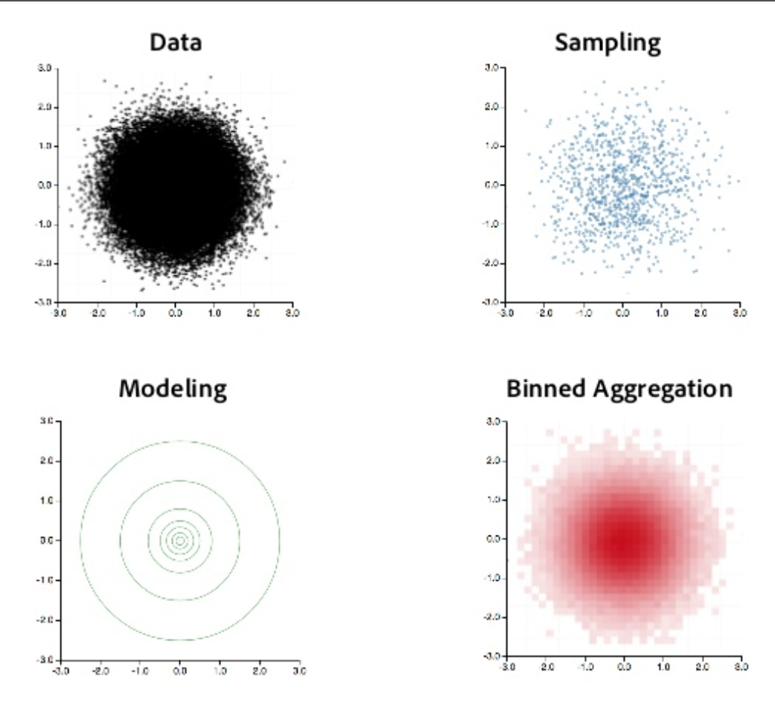
Related Work
Binned Aggregation
Binning aggregates data and visualizes density by counting the number of data points falling within each predefined bin.
Notes:
For a numeric variable, one can define bins as adjacent intervals over a continuous range. For categorical variables, one can simply treat each value as a bin.

Slide 8
Techniques Being Used
1 Designing Binned Plots
2 Enabling Interaction in Binned Plots
3 Some Details

Slide 9
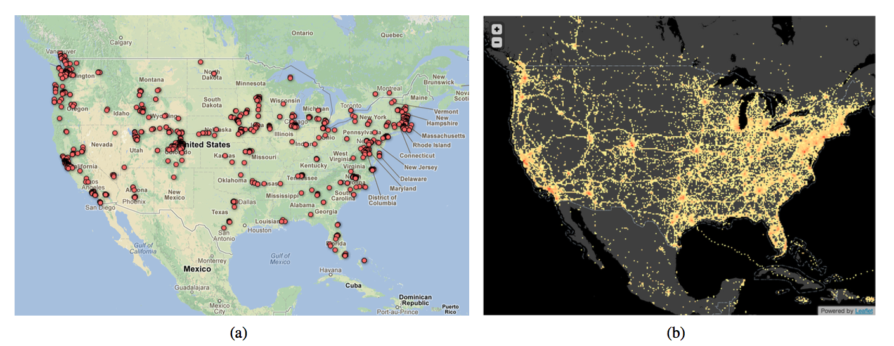
Techniques Being Used
1 Designing Binned Plots
Why? conveys both global patterns (e.g., densities) and local features (e.g., outliers), while enabling multiple levels of resolution via the choice of bin size.
four million user checkins
Notes:
One can see richer information in the heatmap, including patterns on inter-state highways, events outside the US, and a long trail of checkins spanning the coast of Texas and Gulf of Mexico. These are checkins made by Brightkite user account “Hurricane Ike” that report the location of the hurricane along its path in

Slide 10
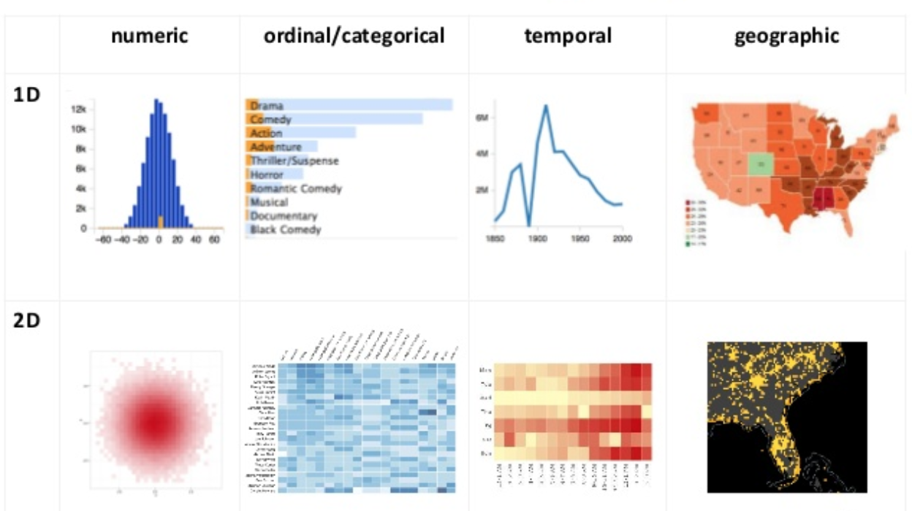
Techniques Being Used
1 Designing Binned Plots
How?
Design Space
Notes:
We consider binning schemes for four data types commonly found in databases: ordinal, numeric, temporal and geo- graphic.
For ordinal and (sorted) categorical data, each distinct value is a bin. We group numeric data into adjacent intervals over a continuous range. Temporal values can be binned at various levels of granularity: year, month, week, day, hour, etc. For geographic data, we treat 1D nominal units such as states or countries as unique bins. If locations are specified as latitude and longitude points, we bin their projected spatial coordinates.

Slide 11
Techniques Being Used
2 Enabling Interaction in Binned Plots
Latency!
Panning and zooming -> finer grained bins
Brushing & linking -> computing aggregates filtered by an initial data selection
How? Multivariate Data Tiles
Notes:
While each binned chart type in the previous section visualizes one or two aggregated dimensions, more data resolution is needed to support interaction. Panning and zooming may require finer grained bins
Brushing & linking, in which selections in one view highlight the corresponding data in other views, requires computing aggregates filtered by an initial data selection

Slide 12
Techniques Being Used
2 Enabling Interaction in Binned Plots
Multivariate Data Tiles
Data Cube - > Multivariate Data Tiles
Apply binned aggregation to get data cube.(Too big to store in memory) Decompose full cube into sub-cubes (at most four dimensions)
Aggregating data tiles - > Brushing & linking behavior
Notes:
for any pair of 1D or 2D binned plots, the maximum number of dimensions needed to support brushing & linking is four (between two binned scatterplots that do not share a dimension )
four 3-dimensional cubes can cover all the possible brushing and linking scenarios shown in Figure 4: (X, Y, Hour), (X, Y, Day), (X, Y, Month), (Hour, Day, Month). If we assume a uniform bin count b, this decomposition reduces the total data record count from b5 to 4b3; when b=50, the reduction is from 312.5M to 0.5M records.

Slide 13
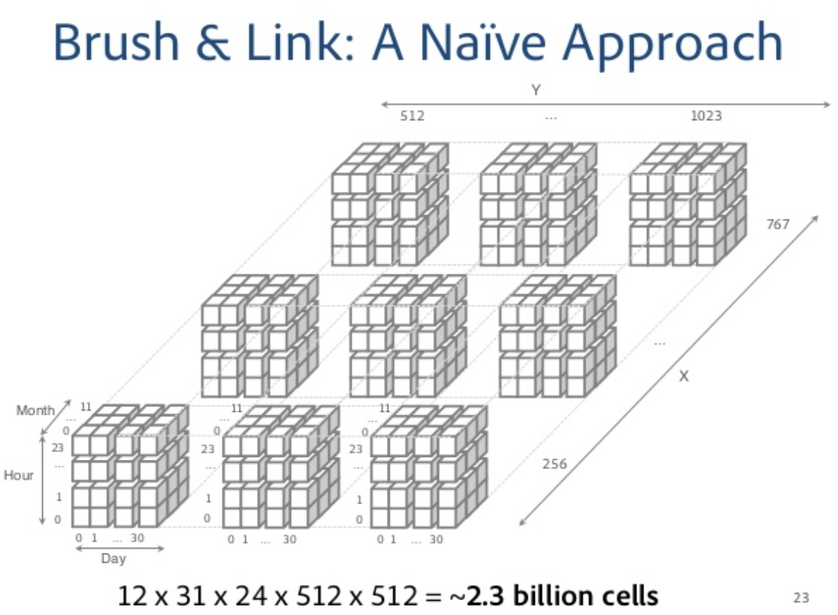
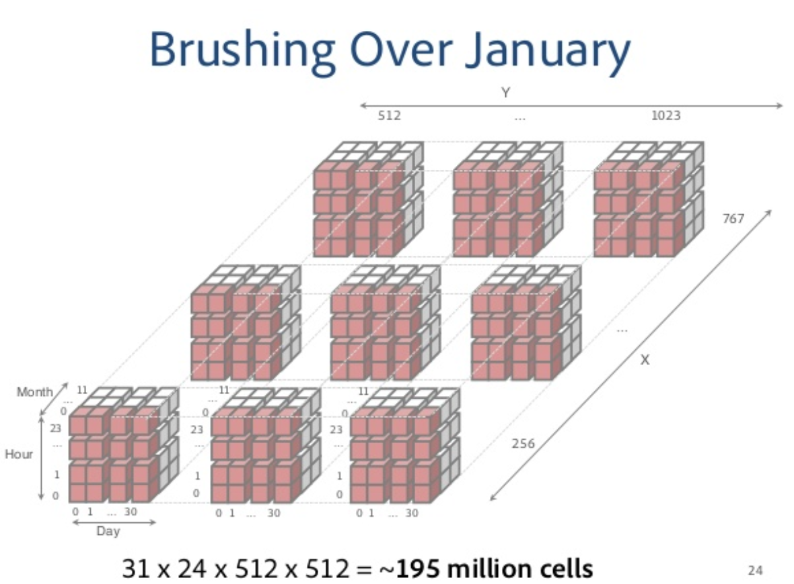
Techniques Being Used

Slide 14
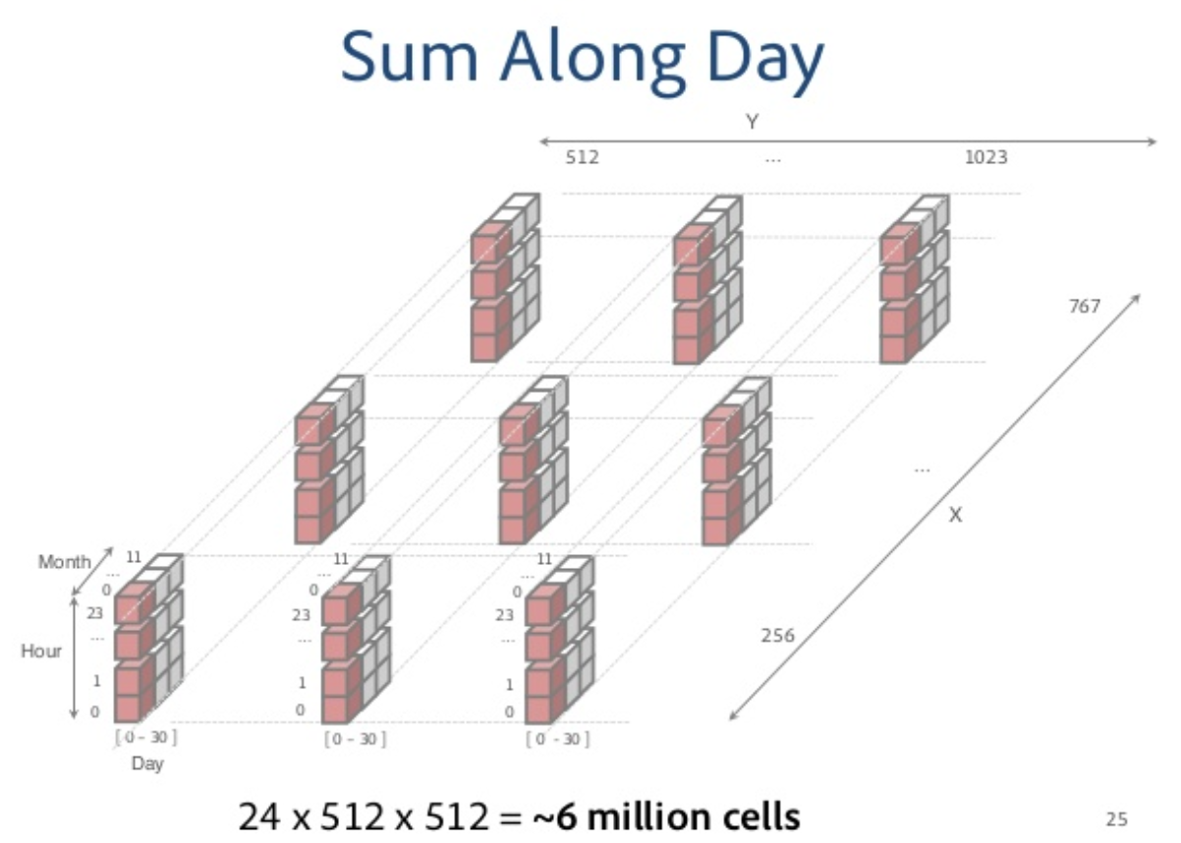
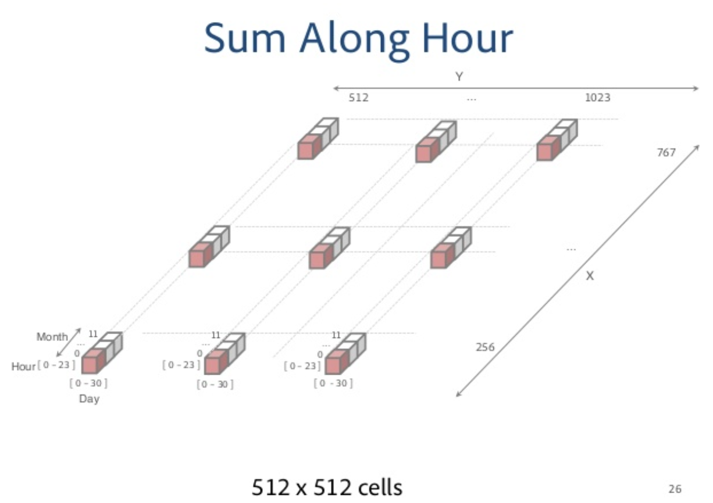
Techniques Being Used

Slide 15
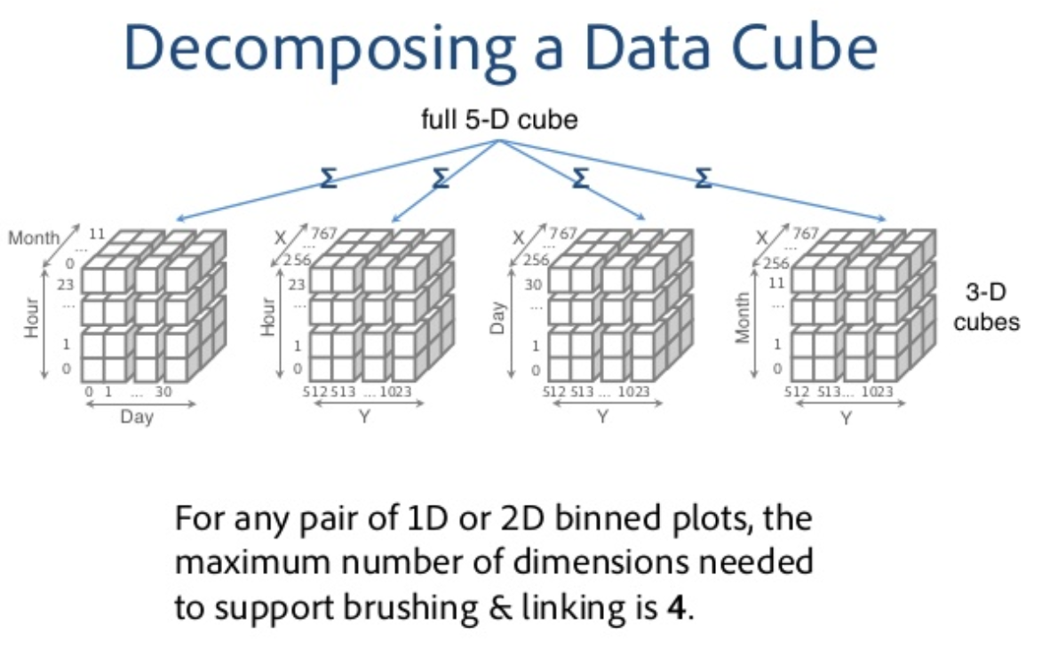
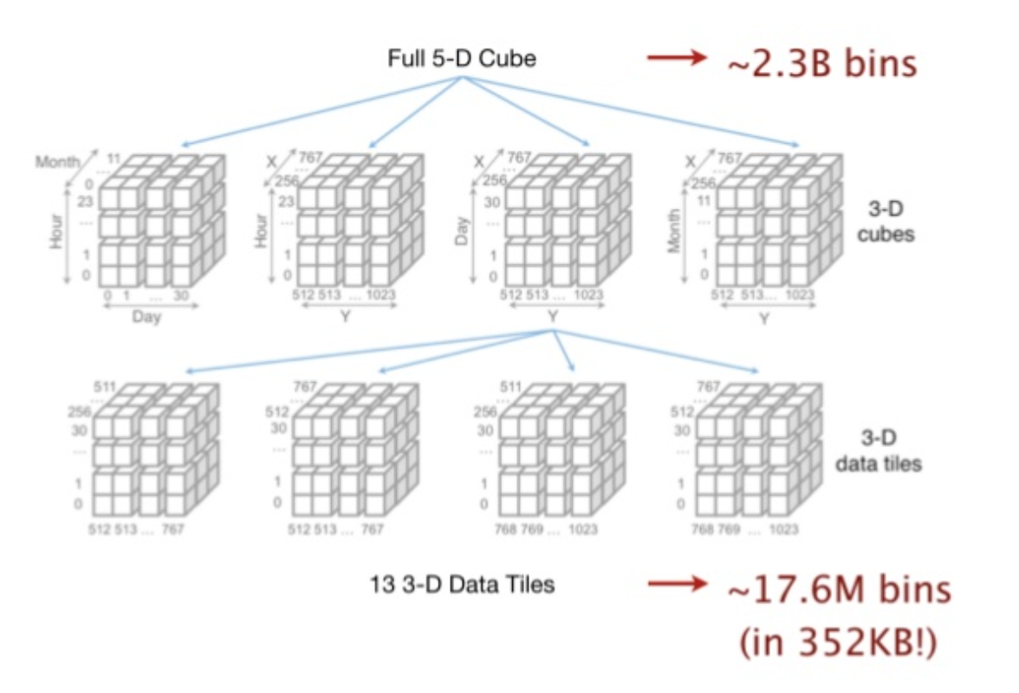
Techniques Being Used

Slide 16
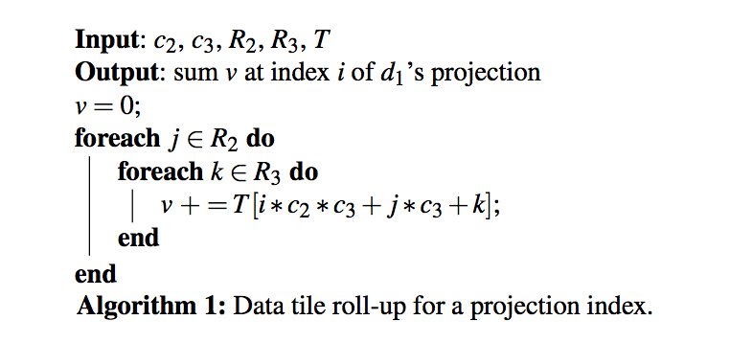
Techniques Being Used
2 Enabling Interaction in Binned Plots
Query?
For each output bin (summed value), we can use a simple loop that accesses only the bins needed for that summation.
Consider a 3D data tile T with dimensions (d1, d2, d3), with respective bin counts (c1, c2, c3). If users brush a 2D binned plot of d2 and d3 to select ranges R2 and R3, we can compute the summed value v at index i of the d1 projection using Algorithm 1. With this simple roll-up procedure, we can run the algorithm in parallel for all c1 indices.

Slide 17
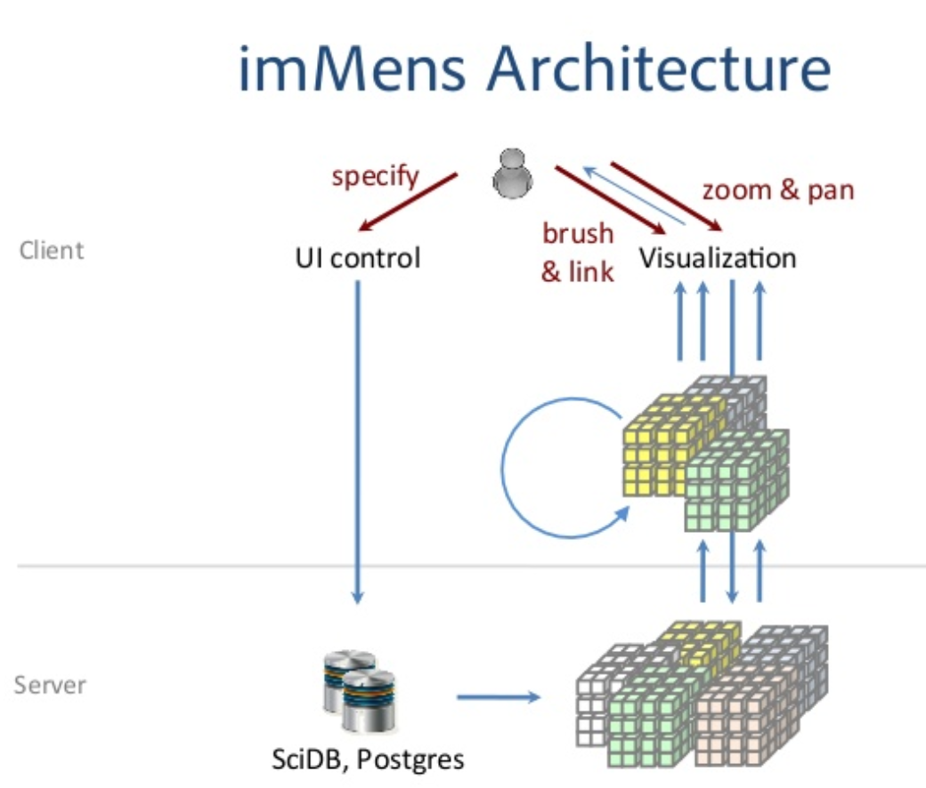
Techniques Being Used
3 Some Details
Storing Data Tiles as Image Files
Parallel Query and Render via Shader Programs
Notes:
Given a visualization definition, im- Mens loads data tiles from a server and provides an interac- tive multiple view display of binned plots within standards- compliant web browsers.
We use WebGL, a JavaScript vari- ant of the OpenGL ES 2.0 specification, to perform GPU- based computation and render visualizations to HTML5 can- vas elements.

Slide 18
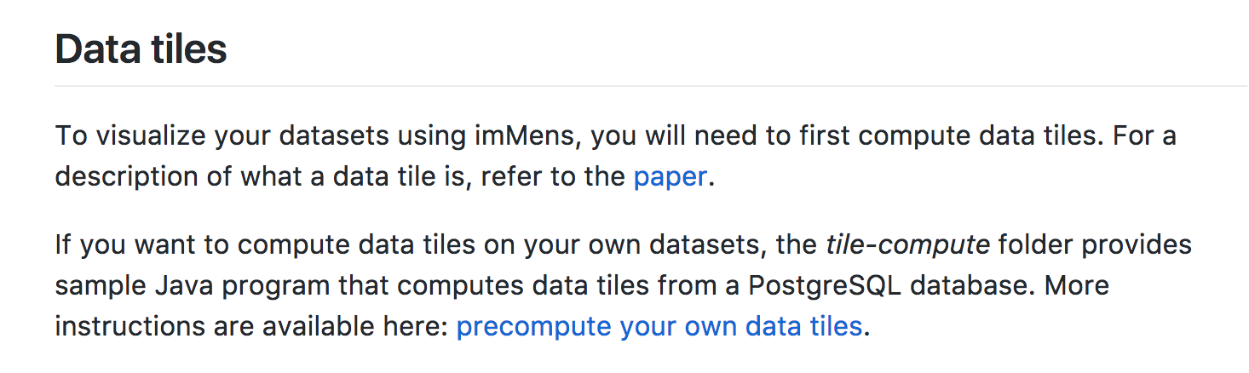
Demo
4.5 million user checkins on Brightkite 35.6 million flight delays in the U.S. from 1989 to 2008 10K to 1B synthetic data points visualized as scatterplot matrices (SPLOM)
https://github.com/uwdata/imMens
https://github.com/uwdata/imMens/wiki

Slide 19
Future Work
Other possible data reduction method apply here other than binned aggregation?
Brushing of more than four dimension?
Visualization construction UI?
Notes:
brushing of more than four dimensions. For example, in the Brightkite visualizations in Fig- ure 4, users may want to explore the geographic distribution of checkins across 24 hours in a particular day. To do so, they may select both a specific month and day, then perform brushing and linking between the Hour histogram and the ge- ographic heatmap.
Another future step is to provide an interface for visu- alization construction. Currently imMens uses hand-coded specifications. In contrast, Tableau’s drag-and-drop interface [Tab] supports dynamic construction of multiscale visualiza- tions. We plan to combine a similar design with the visual- ization and interaction facilities of imMens.

Slide 20
Q&A
Questions?

